Slide 1
Reproduction & Improvement of State-of-art TTS model
Student: Fei Xie Supervisor: Prof. Yike Guo

Slide 2
Main Content
Background Studying
Tacotron2 & Compressed Tacotron2 Design
WaveNet Design
Implementation and Training
Evaluation
Summary
Q&A

Slide 3
Background sTUDY
RNN & LSTM Introduction
Sequence-to-sequence Introduction
Attention Mechanism
Mel-spectrogram
Dropout & Zoneout

Slide 4
Model structure

Slide 5
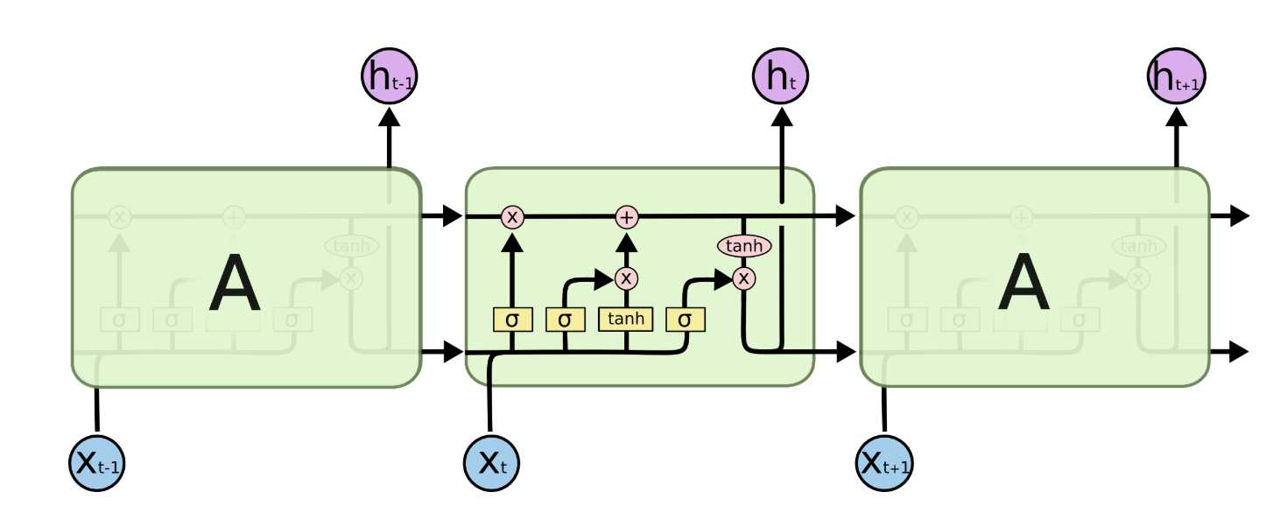
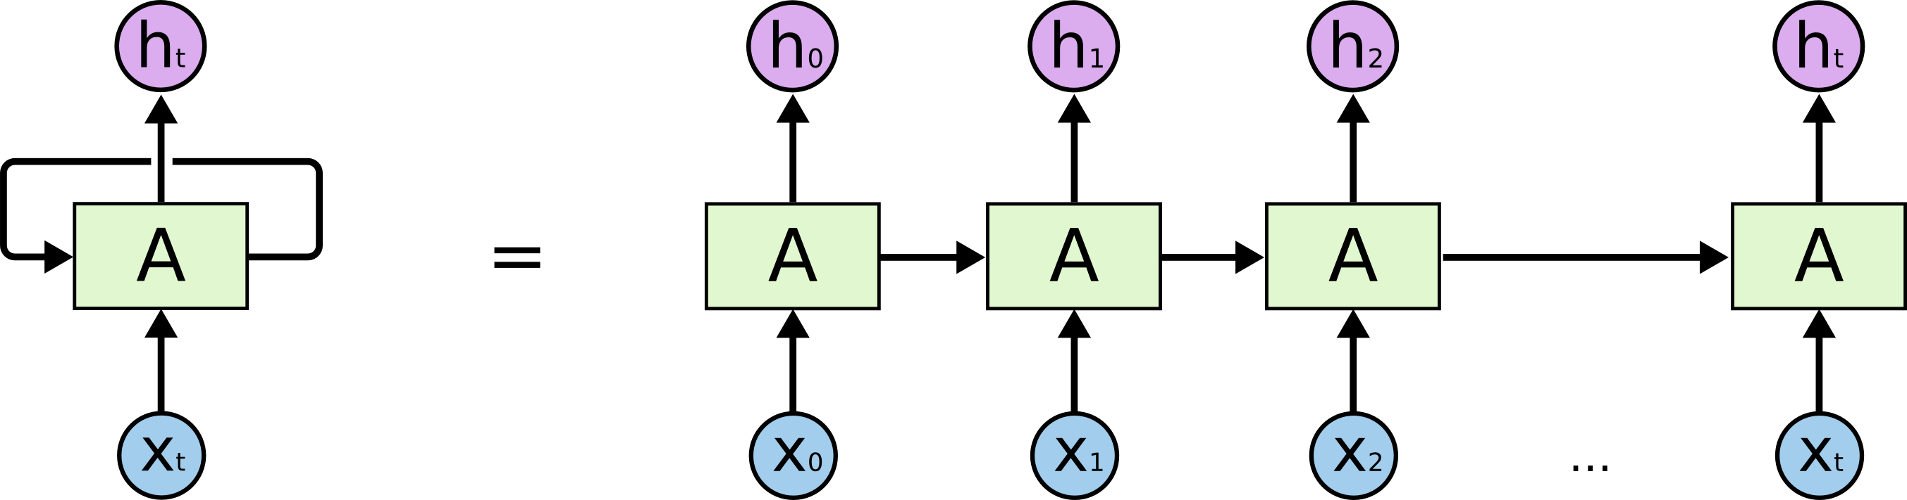
Background Studying
RNN & LSTM
Connections between nodes form a directed graph along a sequence.
Allows it to exhibit temporal dynamic behaviour for a time sequence.
Widely used in Machine Translation and Speech Recognition

Slide 6
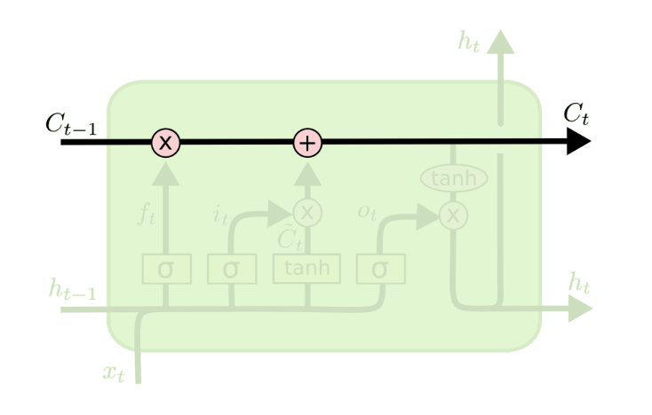
Background Studying
LSTM dETAILS
The cell state can be seen as a conveyor belt.
Only have some linear interactions, it runs straight down the entire chain.

Slide 7
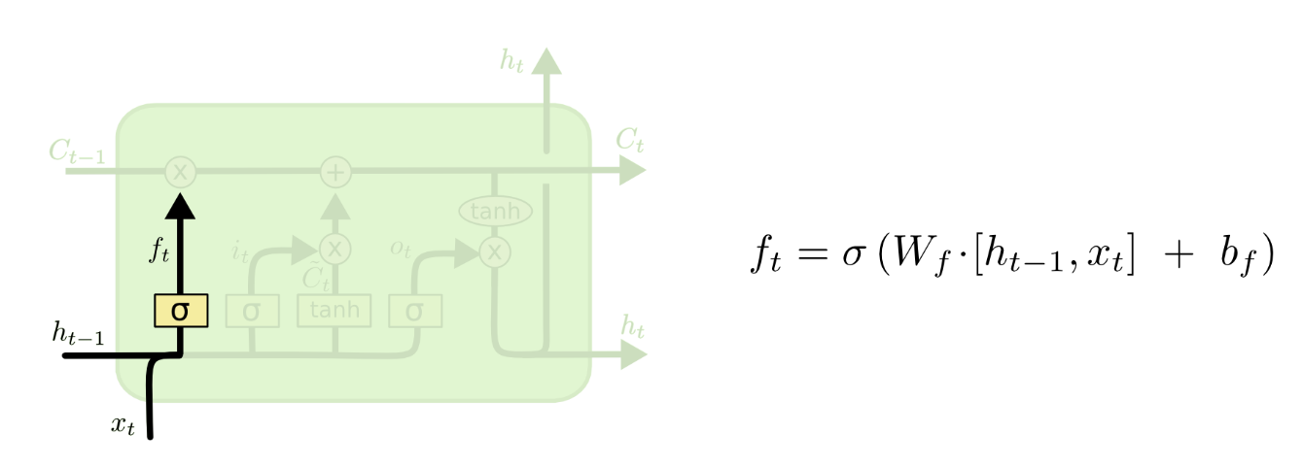
Background Studying
LSTM dETAILS
Forget Gate:
1. h is hidden state which we want
2. The decision is made by a sigmoid layer called Forget Gate Layer.
Forget Gate decide which data should run through the cell state.

Slide 8
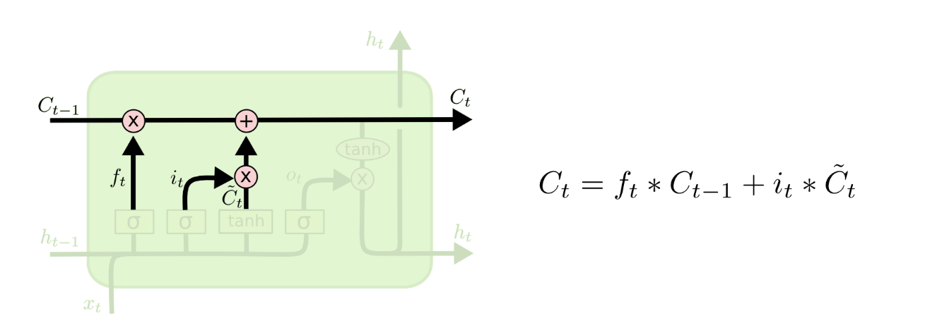
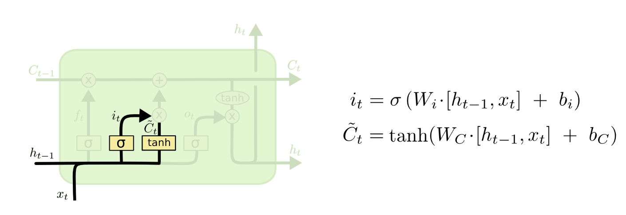
Background Studying
LSTM dETAILS
Update Gate:
Firstly, a sigmoid layer called update gate decides which values to update
A tanh layer creates a vector of new candidate values C_t that could be added to the state.
Update Gate decides which values to update to the cell

Slide 9
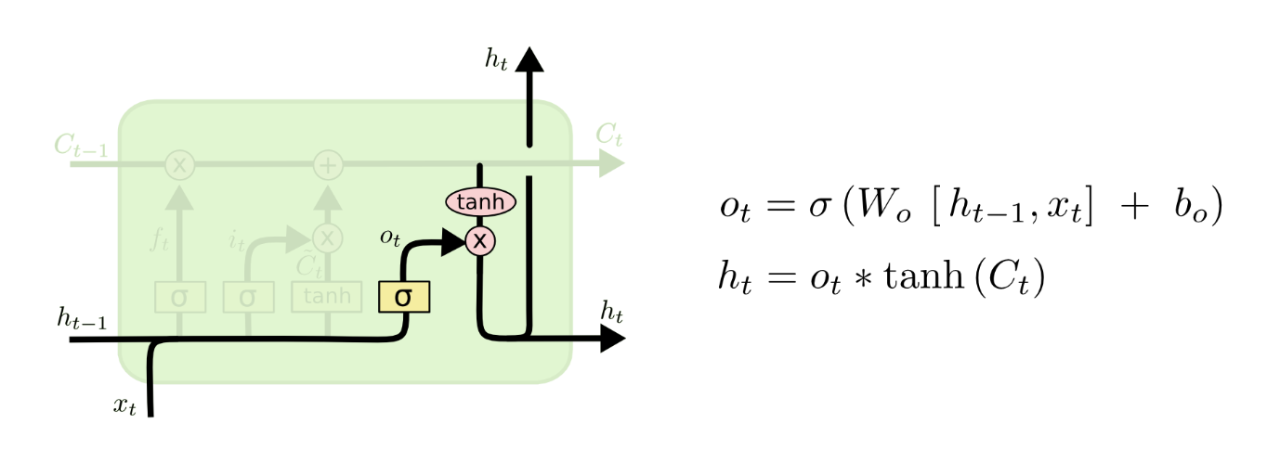
Background Studying
LSTM dETAILS
Output Gate:
1. Sigmoid layer decides what parts of the cell state to output
2. Tanh layer where to rescale the new cell state and multiply it to the output of sigmoid gate,
Output Gate decide what need to be output

Slide 10
Background Studying
1. Both of these parts are two different models combined to form one giant network.
2. Encoder network: understand the input sequence, and transform into a smaller representation.
3. Decoder network: Generates a sequence based on Encoder as output.
Sequence to sequence Model

Slide 11
Why using S2S model?
1. Traditional deep neural networks only to solve problems with their inputs and targets can be encoded in fixed dimensionality.
2. Many important problems are necessary to be expressed in sequences whose lengths are not known in advance.

Slide 12
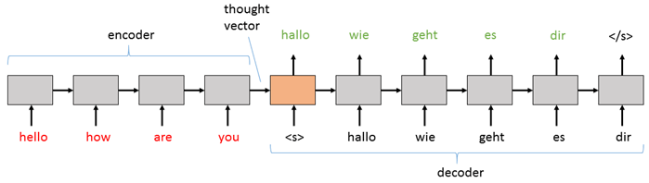
Background Studying
Example: English to German

Slide 13
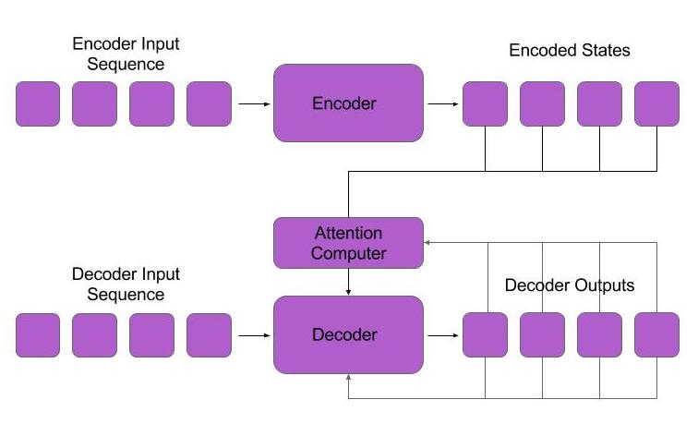
Background Studying
Attention Model
An attention mechanism can:
let the model learn what part of the input features to attend based on the sentence input before and what it has produced so far.

Slide 14
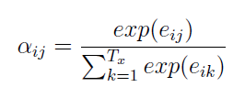
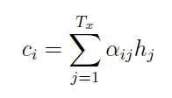
Background Studying
Attention Model
Encoder

Slide 15
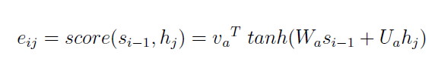
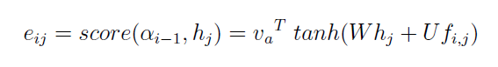
Background Studying
AttentionTypes
Content Based Attention:
s is hidden state of Decoder
a is output of Encoder
Location Based Attention:
The features of previous alignments a_i-1 need to go through a convolution layer to get f_ij

Slide 16
Background Studying
Attention Align Example

Slide 17
Background Studying
Intermediate Feature Representation – Mel-spectrogram
A spectrogram is a kind of representation to demonstrate the spectrum of frequencies of sound because of their attributes of varying with time.

Slide 18
Why we choose Mel-spectrogram to be the intermediate data?
1. Firstly it is easily computed from time-domain waveforms, which helps us train the two basic systems(Tacotron2 and WaveNet) separately
2. Secondly it is smoother than waveform samples and its loss can be measured by squared error method.

Slide 19
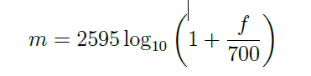
Transform of Mel-spectrogram

Slide 20

Background Studying
Dropout & Zoneout
Dropout:
Dropping out units (both hidden and visible) in a Neural Network
Zoneout, a novel method for regularizing RNNs.
Each timestep, zoneout stochastically forces some hidden units to maintain their previous values.
Uses random noise to train a pseudo-ensemble, improving generalization.

Slide 21
Network Design

Slide 22
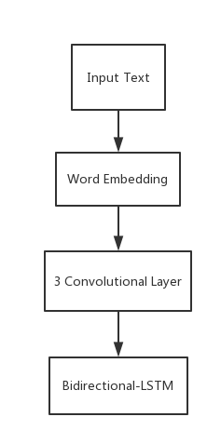
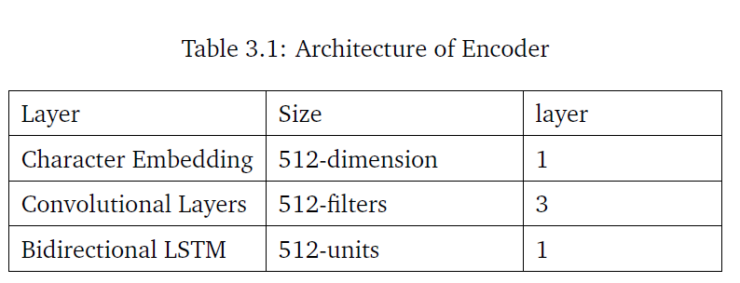
Network design
Encoder Structure

Slide 23
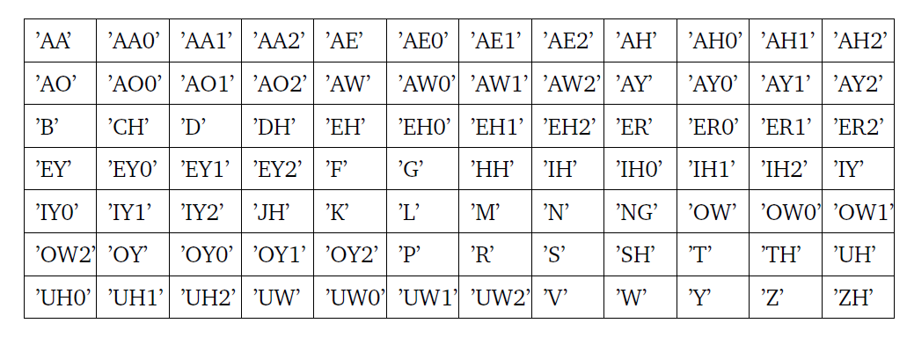
Network design
Word Embedding
CMU Pronouncing Library:
Consisting of about 134,000 words and corresponding pronunciations.
It is an pronunciation dictionary by transforming the word in text to which can be read by machine for North American English.

Slide 24
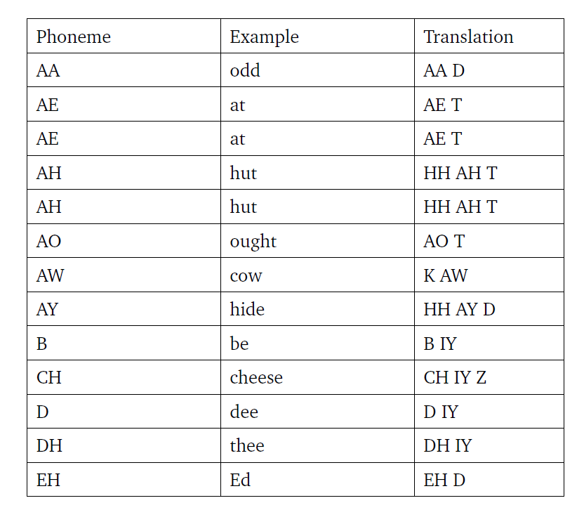
Word Embedding Example

Slide 25
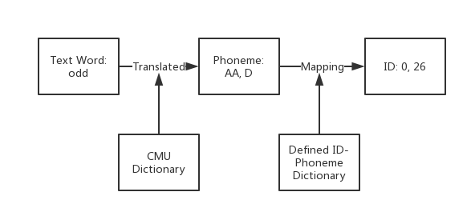
Network design
Word Embedding Process

Slide 26
Network design
Why using Convolution Layer in Encoder?
1. Similarly in image process to extract local correlations between each pixels, CNN can be applied to character embedding matrix to find correlations between characters.
2 Using CNN layers gives Tacotron2 a long-term independent context
For example, Floor and Flour, similar spell but different pronunciation
3. Can make model robust in the situation of some words with silent characters such as ’k’ in ’know’ and ’d’ in ’django’.

Slide 27
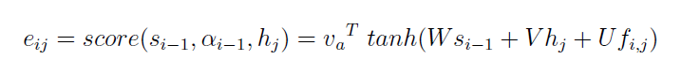
Network design
Attention Used
Tacotron2 adapted a type of model of hybrid attention, which is the mix of two previous described attention models.

Slide 28
Network design
Pre-Net:
2-fully connected layers of 256 hidden ReLU units
Decoder Structure

Slide 29
Network design
Data Flow in Details
Pre-net will process the prediction from last step
2. Output will be concatenated with the context vector made by Attention
3. Feed to a stack of 2 Bi-directional LSTM layers
4. The concatenation of the LSTM output and the context vector from attention net will be projected within a liner transform
5. Liner Projection then into 5-layer convolutional network

Slide 30
Network design
Compressed Network Design
Post-Net is 5 layer Convolution Networks
WaveNet is also consisted with Convolution Networks
Try to Delete Post-Net and train to compare
Apply Dropout & Zoneout

Slide 31
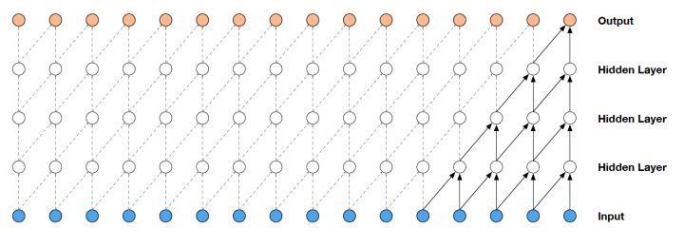
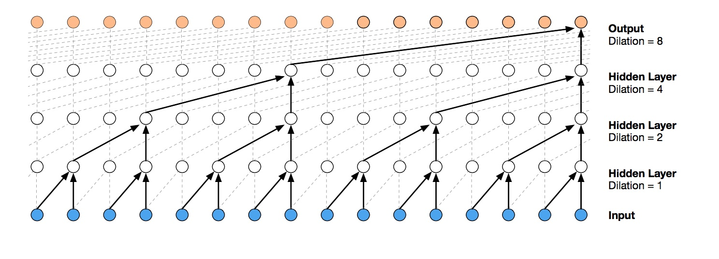
Network design
WaveNet Design
Dilated Network: Each neuron is a convolution neuron
Reason: Do not have recurrent connections, they are typically faster to train than RNNs
Skipped Dilated Network:
Due to the speech attributes which need to sample from large time scales, we need to skip some neurons
If dilation=1, t, t-2, t-4 will be adapted

Slide 32
Network design
WaveNet Processing

Slide 33
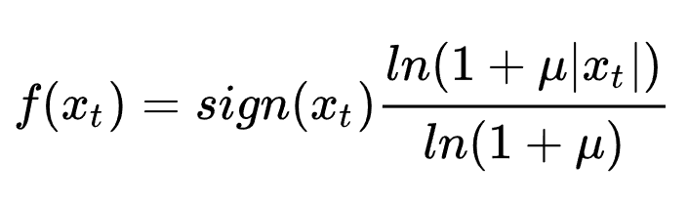
Network design
WaveNet Design
Mu law to transform the original 65536 possible outputs into 256 outputs
So the problem become a classification problem with 256 labels
Many experiments have shown that the final waveform is not affected by this transformation

Slide 34
Implementation process

Slide 35
Original Model Loss Changing
Before_loss
After_loss
Stop_token loss
Total_loss
Total Steps: 125,000 steps
Before_loss: 0.02 After_loss: 0.004
Total_loss: 0.03 Stop_token_loss: 0

Slide 36
Original Model: Mel-Spectrogram Prediction based on training data
Step 10,000
Step 50,000
Step 100,000
Step 125,000

Slide 37
Original Model:Mel-Spectrogram Aligns based on training data
Step 10,000
Step 50,000
Step 100,000
Step 125,000

Slide 38
Compressed Model Loss Changing
Before_loss
After_loss
Stop_token loss
Total_loss
Total Steps: 195,000 steps Before_loss: 0.13
After_loss: 0.082 Total_loss: 0.212
Stop_token_loss: 0
Keep unchanged around 100,000 steps

Slide 39
Compressed Model: Mel-Spectrogram Prediction based on training data
Step 5,000
Step 50,000
Step 100,000
Step 190,000

Slide 40
Compressed Model:Mel-Spectrogram Aligns based on training data
Step 10,000
Step 50,000
Step 100,000
Step 190,000

Slide 41
Implementation Process
WaveNet Training
Total Steps: 1.16 million steps
Cost Time: 1 month
Final Loss: 6.00

Slide 42
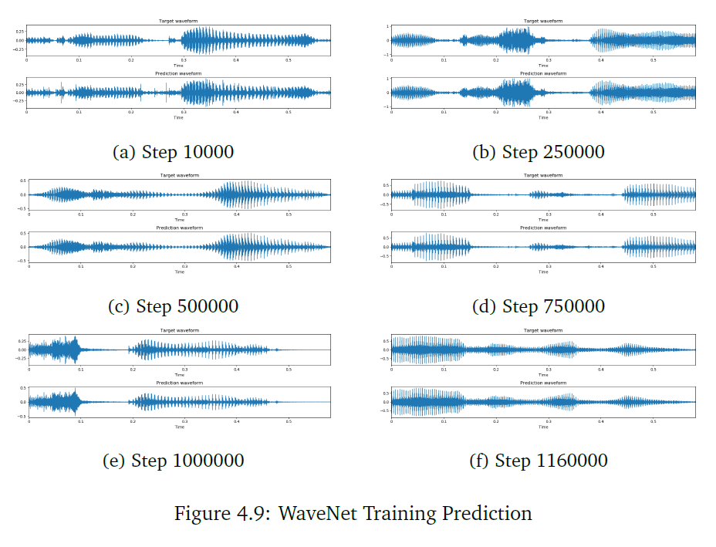
Implementation Process
WaveNet Prediction Based on Training Data
1. Predicted waveform is very similar or even the same as the ground truth of data,
2. The networks are trained effective with the training data set.

Slide 43
eVALUATION
WaveNet Evaluation
Tacotron2 Output Evaluation
Final Output Evaluation

Slide 44
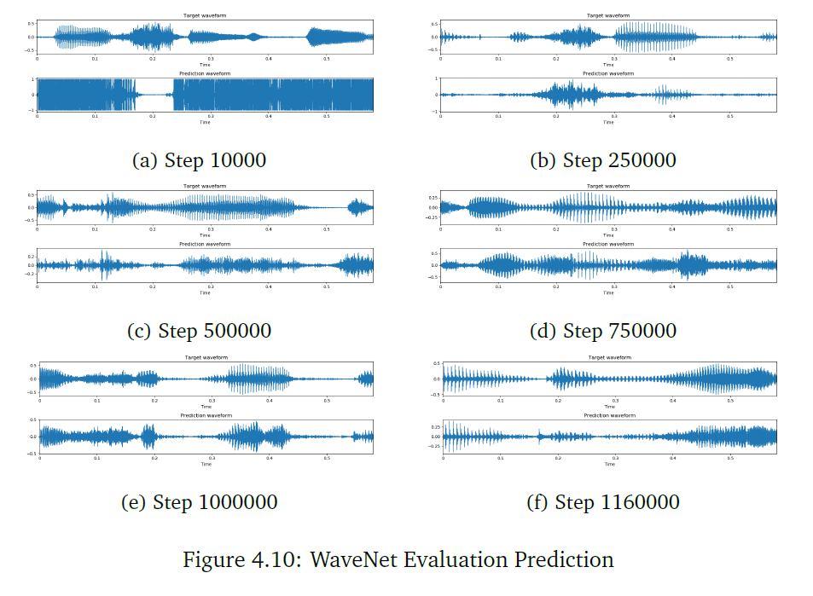
Evaluation
WaveNet Evaluation
The prediction on the first 10,000 steps, the waveforms is really noisy with an unclear waveform.
Quality is getting positive with the training steps increasing.
Some necessary peak parts of the prediction waves start showing corresponding to the real one.
1.16 million steps present almost the same waves with the ground truth.

Slide 45
Tacotron2 output test:
Three test sentences:
Scientists at the CERN laboratory say they have discovered a new particle.
There’s a way to measure the acute emotional intelligence that has never gone out of style.
President Trump met with other leaders at the Group of 20 conference

Slide 46

Original Model:
Three test sentences:
Scientists at the CERN laboratory say they have discovered a new particle.
There’s a way to measure the acute emotional intelligence that has never gone out of style.
President Trump met with other leaders at the Group of 20 conference

Slide 47
Compressed Model:
Three test sentences:
Scientists at the CERN laboratory say they have discovered a new particle.
There’s a way to measure the acute emotional intelligence that has never gone out of style.
President Trump met with other leaders at the Group of 20 conference

Slide 48
Final Result Comparison
Scientists at the CERN laboratory say they have discovered a new particle.
There’s a way to measure the acute emotional intelligence that has never gone out of style.
President Trump met with other leaders at the Group of 20 conference
Sentence | Original Model | Compressed Model
1
2
3

Slide 49
Weakness and Limitation
Example Sentence:
• Data science is by nature at the core of all modern transdisciplinary scientific
activities, as it involves the whole life cycle of data, from acquisition and
exploration to analysis and communication of the results.
• Data science is not only concerned with the tools and methods to obtain,
manage and analyse data: it is also about extracting value from data and
translating it from asset to product. Launched on 1st April 2014, the Data
Science Institute at Imperial College London aims to enhance Imperials excellence
in data driven research across its faculties by fulfilling the following
objectives.
The inference time of WaveNet which is too long.
The inference time on Tacotron is only 38 seconds including two above sentence but WaveNet is 38 miniutes and 1 hour 10 minutes respectively.
Bad for long sentence

Slide 50
Summary
The compressed model using Dropout and Zoneout to avoid the overfitting problems and also delete the final duplicated layers of convolution to the WaveNet part will still make the inference much more faster.
Some more advanced WaveNet structures need to be tested for improving the time of inference of the WaveNet structure discussed in this project, such as Parallel WaveNet

Slide 51
Q&A

